Slide 1
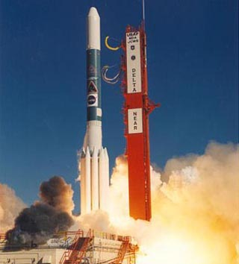
Rocket Propulsion
By Harry Ahn

Slide 2
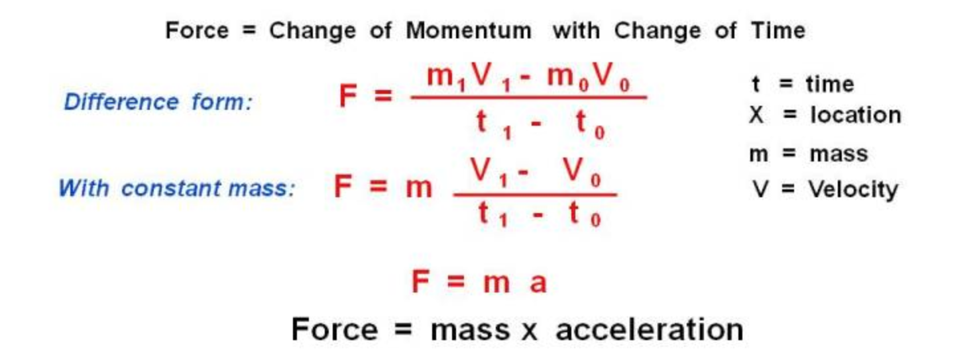
Newton’s Second Law of motion

Slide 3
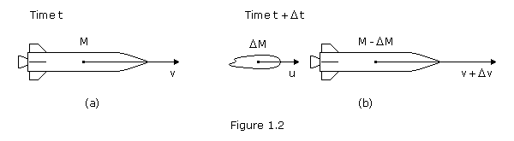
STEP 1
ΔP = P2 - P1= ( M + ΔM )( V + ΔV )- MV = MΔV + VΔM +ΔMΔV
Momentum of exhaust = - ΔMass of fuel ( velocity of rocket - velocity of exhaust ) = ( -ΔM )( V-C )
V - C
ΔP = ( MΔV + VΔM + ΔMΔV ) + ( -ΔM )( V-C ) = MΔV + CΔM + ΔMΔV

Slide 4



STEP 2
Since F= sum of all Forces, F = Force of Air resistance + force of Gravity

Slide 5
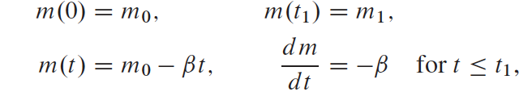

Rocket Equation
STEP 3
From a time interval [ 0, T1] and By plugging these values into
=

Slide 6
Rocket Equation Application
The V-2 rocket that was used to attack London in World War II had an initial mass of 12,850 kg, of which 68.5% was fuel. This fuel burned uniformly for 70 seconds with an exhaust velocity of 2 km/s. Assume it encounters air resistance of 1.45 N per m/s of velocity. Then find the velocity and altitude of the V-2 at burnout under the assumption that it is launched vertically upward from rest on the ground.

